Slide 1
Data Structures
Programming Project #2
郭建志

Slide 2
Data Center
A data center consists of multiple severs
The servers are connected by switches in a local area network
destination
source

Slide 3
Switches
Each switch has multiple ports
Receive and forward the packets from a port to another port

Slide 4
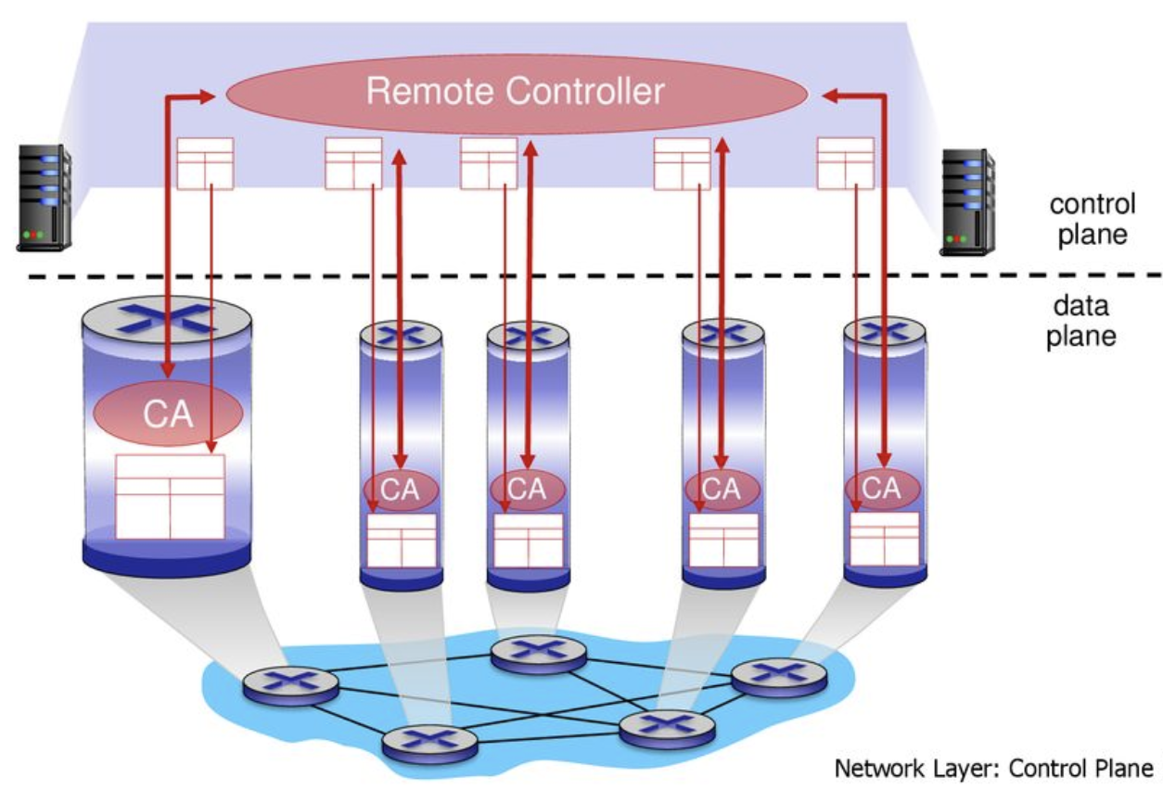
SDN-enabled Switches
A centralized controller is introduced – software-defined networking (SDN)

Slide 5
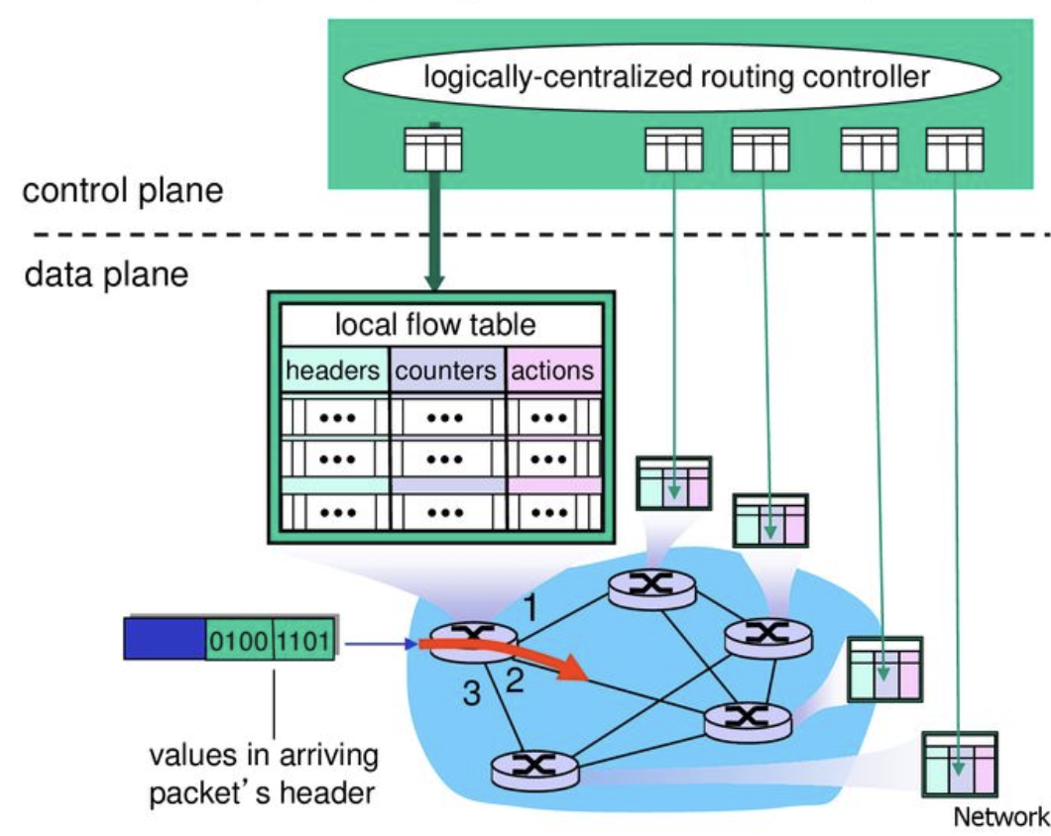
Installing Rules in the SDN-enabled Switches

Slide 6
Routing Path Update (aka Network Update)
Given the old and new routing paths
Update the routing paths
3
4
3
4
0
1
2
0
1
2
0 | 1 | 2 | 3 | 4
1 | 2 | 4 | -1 | -1
0 | 1 | 2 | 3 | 4
2 | 3 | 1 | 4 | -1

Slide 7
Difficulty of Network Update in SDN
The controller is logically-centralized
However, the underlying mechanism is distributed
Each switch receives the update message and updates its rule independently and asynchronously
drop
3
4
3
4
0
1
2
0
1
2
0 | 1 | 2 | 3 | 4
1 | 2 | 4 | -1 | -1
0 | 1 | 2 | 3 | 4
1 | 3 | 4 | -1 | -1

Slide 8
Difficulty of Network Update in SDN
The controller is logically-centralized
However, the underlying mechanism is distributed
Each switch receives the update message and updates its rule independently and asynchronously
How to solve the issue?
Two-phase commit (SIGCOMM 2012)
Round-based update (TON, 2018)
“Survey of Consistent Software-Defined Network Updates”, in IEEE Communications Surveys & Tutorials, 2019

Slide 9

Difficulty of Network Update in SDN
Two-phase commit (SIGCOMM 2012)
Drawback: waste the TCAM size during the update
match
C
D
3
4
#Final
#Initial
match
#F
S
#T
A
B
0
1
2
match
match

Slide 10
Difficulty of Network Update in SDN
Round-based update (單純概念介紹)
Step 2: Update 1
3
4
3
4
0
1
2
0
1
2
Step 1: Update 0 and 3
Step 3: Update 2
3
4
3
4
0
1
2
0
1
2

Slide 11
Programming Project #2: Minimize the number of update rounds
Input:
Numbers of nodes in old and new paths
Nodes in old and new paths
Procedure:
Minimize the rounds of update
Output:
Rules of each switch in each round
The grade is inversely proportional to the number of rounds

Slide 12
Programming Project #2: Minimize the number of update rounds
Input:
Numbers of nodes in old and new paths
Nodes in old and new paths
Procedure:
Minimize the rounds of update
Output:
Rules of each switch in each round
The grade is inversely proportional to the number of rounds
…

Slide 13
Programming Project #2: Minimize the number of update rounds
Input:
Numbers of nodes in old and new paths
Nodes in old and new paths
Procedure:
Minimize the rounds of update
Output:
Rules of each switch in each round
The grade is inversely proportional to the number of rounds
怎麼辦

Slide 14
Programming Project #2: Minimize the number of update rounds
Input:
Numbers of nodes in old and new paths
Nodes in old and new paths
Procedure:
Minimize the rounds of update
Output:
Rules of each switch in each round
The grade is inversely proportional to the number of rounds
早知道不加簽了

Slide 15
Programming Project #2: Round-based network update
Input:
Numbers of nodes in old and new paths
Nodes in old and new paths
Procedure:
Compute each round of update
Output:
Rules of each switch in each round
Implement a given algorithm.
禮拜四
告訴你

Slide 16
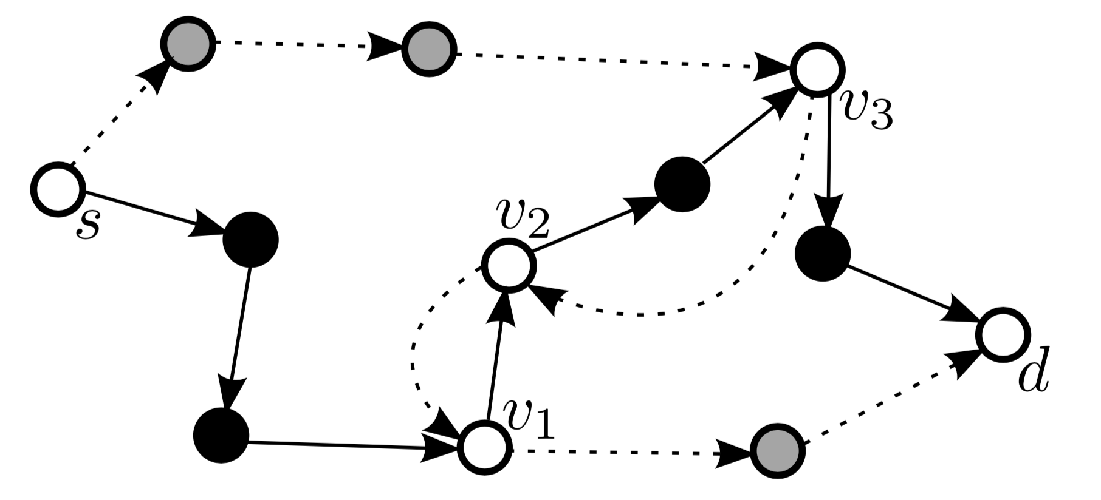
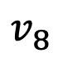
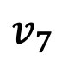
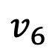
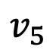
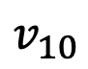
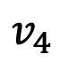
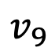
Round-Based Update Algorithm (TON, 2018)
Solid line: old path Dashed line: new path
s | 1 | 2 | 3 | 4 | 5 | 6 | 7 | 8 | 9 | 10 | d
7 | 2 | 9 | 10 | -1 | -1 | -1 | 8 | 1 | 3 | d | -1
$$v_{4}$$
$$v_{5}$$
$$v_{9}$$
$$v_{7}$$
$$v_{10}$$
$$v_{8}$$
$$v_{6}$$
s | 1 | 2 | 3 | 4 | 5 | 6 | 7 | 8 | 9 | 10 | d
4 | 6 | 1 | 2 | 5 | 3 | d | -1 | -1 | -1 | -1 | -1

Slide 17
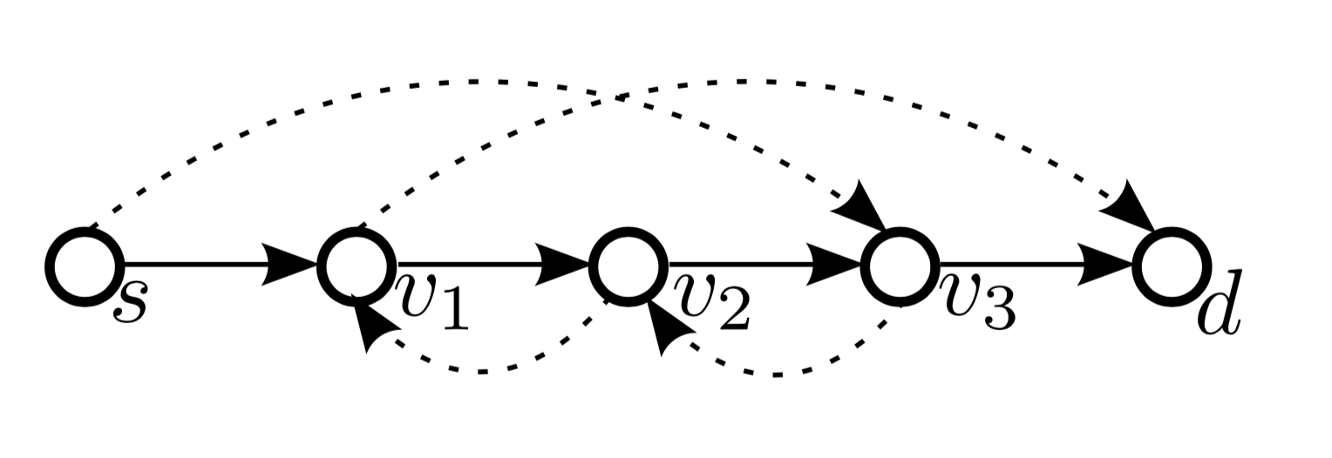
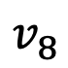
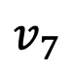
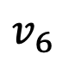
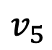
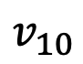
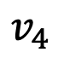
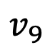
Round-Based Update Algorithm (TON, 2018)
Solid line: old path Dashed line: new path
Add the rules in red nodes in the first round
Remove the rules in black nodes in the last round
➔ Reduce the the network to the line representation
$$v_{4}$$
$$v_{5}$$
They didn’t receive before update
They will not receive after update
$$v_{9}$$
$$v_{7}$$
$$v_{10}$$
$$v_{8}$$
$$v_{6}$$

Slide 18
Round-Based Update Algorithm (TON, 2018)
Solid line: old path Dashed line: new path
Add the rules in red nodes in the first round
Remove the rules in black nodes in the last round
➔ Reduce the the network to the line representation
s | 1 | 2 | 3 | 4 | 5 | 6 | 7 | 8 | 9 | 10 | d
7 | 2 | 9 | 10 | 5 | 3 | d | 8 | 1 | 3 | d | -1
0th round

Slide 19
Round-Based Update Algorithm (TON, 2018)
Solid line: old path Dashed line: new path
Add the rules in red nodes in the first round
Remove the rules in black nodes in the last round
➔ Reduce the the network to the line representation
s | 1 | 2 | 3 | 4 | 5 | 6 | 7 | 8 | 9 | 10 | d
4 | 2 | 9 | 10 | 5 | 3 | d | 8 | 1 | 3 | d | -1
1nd round

Slide 20
Round-Based Update Algorithm (TON, 2018)
Solid line: old path Dashed line: new path
Add the rules in red nodes in the first round
Remove the rules in black nodes in the last round
➔ Reduce the the network to the line representation
s | 1 | 2 | 3 | 4 | 5 | 6 | 7 | 8 | 9 | 10 | d
4 | 6 | 1 | 10 | 5 | 3 | d | 8 | 1 | 3 | d | -1
2nd round

Slide 21
Round-Based Update Algorithm (TON, 2018)
Solid line: old path Dashed line: new path
Add the rules in red nodes in the first round
Remove the rules in black nodes in the last round
➔ Reduce the the network to the line representation
s | 1 | 2 | 3 | 4 | 5 | 6 | 7 | 8 | 9 | 10 | d
4 | 6 | 1 | 2 | 5 | 3 | d | 8 | 1 | 3 | d | -1
3rd round

Slide 22
Round-Based Update Algorithm (TON, 2018)
Solid line: old path Dashed line: new path
Add the rules in red nodes in the first round
Remove the rules in black nodes in the last round
➔ Reduce the the network to the line representation
s | 1 | 2 | 3 | 4 | 5 | 6 | 7 | 8 | 9 | 10 | d
4 | 6 | 1 | 2 | 5 | 3 | d | -1 | -1 | -1 | -1 | -1
4th round

Slide 23
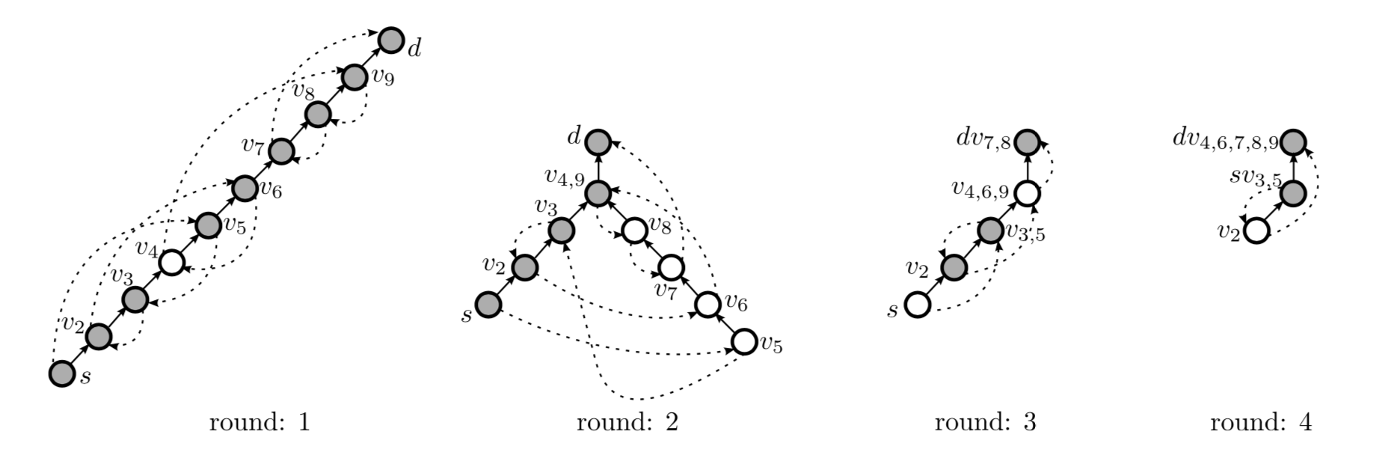
Round-Based Update Algorithm (TON, 2018)
Shortcut phase: used in odd rounds
Iteratively select each edge that has the farthest reaching distance and does not interfere with the selected edges
Update those selected edges

Slide 24
Round-Based Update Algorithm (TON, 2018)
Prune phase: used in even rounds
Update all nodes that are not on the current path from the source to the destination

Slide 25
Round-Based Update Algorithm (TON, 2018)
Peacock algorithm Repeat the two phase until all nodes are updated
Shortcut phase: used in odd rounds
Prune phase: used in even rounds

Slide 26
Discussion
Minimizing the number of update rounds is NP-hard
You cannot find an efficient algorithm for this problem unless NP = P
There are many heuristic algorithms
“Loop-Free Route Updates for Software-Defined Networks,” in IEEE/ACM TON 2018 (你們要實作的）
…

Slide 27
Input Sample: input.txt
Format:
#Nodes
Path1
Path2
e.g.,
12
7 2 9 10 -1 -1 -1 8 1 3 11 -1
4 6 1 2 5 3 11 -1 -1 -1 -1 -1
s | 1 | 2 | 3 | 4 | 5 | 6 | 7 | 8 | 9 | 10 | d
7 | 2 | 9 | 10 | -1 | -1 | -1 | 8 | 1 | 3 | d | -1
s | 1 | 2 | 3 | 4 | 5 | 6 | 7 | 8 | 9 | 10 | d
4 | 6 | 1 | 2 | 5 | 3 | d | -1 | -1 | -1 | -1 | -1

Slide 28
Output Sample: output.txt
s | 1 | 2 | 3 | 4 | 5 | 6 | 7 | 8 | 9 | 10 | d
7 | 2 | 9 | 10 | -1 | -1 | -1 | 8 | 1 | 3 | d | -1
s | 1 | 2 | 3 | 4 | 5 | 6 | 7 | 8 | 9 | 10 | d
7 | 2 | 9 | 10 | 5 | 3 | d | 8 | 1 | 3 | d | -1
Format:
#Rounds
Path1
Path2
…
e.g.,
6
7 2 9 10 -1 -1 -1 8 1 3 11 -1
7 2 9 10 5 3 11 8 1 3 11 -1
4 2 9 10 5 3 11 8 1 3 11 -1
4 6 1 10 5 3 11 8 1 3 11 -1
4 6 1 2 5 3 11 8 1 3 11 -1
4 6 1 2 5 3 11 -1 -1 -1 -1 -1
s | 1 | 2 | 3 | 4 | 5 | 6 | 7 | 8 | 9 | 10 | d
4 | 2 | 9 | 10 | 5 | 3 | d | 8 | 1 | 3 | d | -1
s | 1 | 2 | 3 | 4 | 5 | 6 | 7 | 8 | 9 | 10 | d
4 | 6 | 1 | 10 | 5 | 3 | d | 8 | 1 | 3 | d | -1
s | 1 | 2 | 3 | 4 | 5 | 6 | 7 | 8 | 9 | 10 | d
4 | 6 | 1 | 2 | 5 | 3 | d | 8 | 1 | 3 | d | -1
s | 1 | 2 | 3 | 4 | 5 | 6 | 7 | 8 | 9 | 10 | d
4 | 6 | 1 | 2 | 5 | 3 | d | -1 | -1 | -1 | -1 | -1

Slide 29
0.
1.
2.
3.
4.
5.

Slide 30
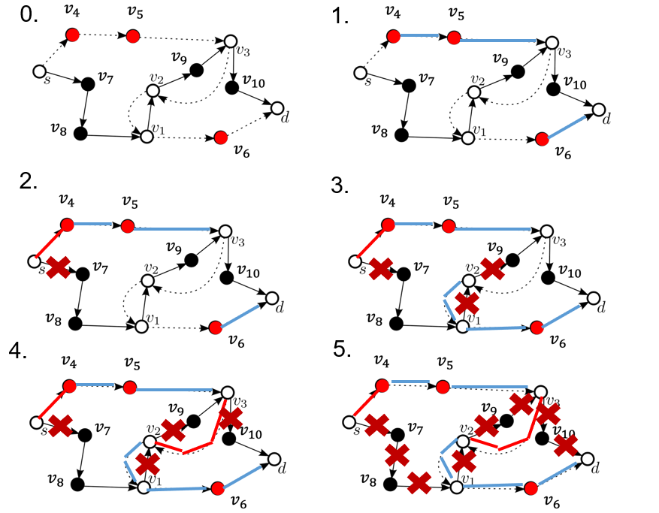
步驟 | 說明
1 | 把沒有指向其他節點的節點(-1) 虛線連起來
2 | 要走到V3 故所以 連起V4 沒有實線交叉的 可以更新兩條
3 | 更新s -> d 沒有經過的所有節點(符合的連起虛線 斷掉實線 )
4 | 拉剩下的虛線(符合的連起虛線 斷掉實線 )
5 | 判斷虛線完成後 刪除剩下所有實線

Slide 31
Odd階段討論案例
要選1 因為Index小
1
2
選了紅色2可以同時更新 1,3不行同時更新因Odd不可往左
2
1
3

Slide 32
Odd階段討論案例
選了紅色2可以同時更新 1,3不行同時更新因Odd不可往左

Slide 33
Odd階段討論案例
選了紅色 可以更新2，1不能更新
2
1
選了紅色 可以再選1 3 因為Index小，2跟1衝突不選
1
2
3

Slide 34
Odd階段討論案例
選了紅色 可再選2
因2走的距離比1遠

Slide 35
Odd階段Merge後討論案例
跨不同線
可更新 不衝突
中間不可更新

Slide 36
Input2(助教公開測資) 原始圖
4
5
6
s
1
2
3
d
7
8
9
10

Slide 37
Input2(助教公開測資) Red
4
5
6
s
1
2
3
d
7
8
9
10

Slide 38
Input2(助教公開測資) Odd1 (怕太亂簡化Red Black)
s
1
2
3
d

Slide 39
Input2(助教公開測資) Even1 (怕太亂簡化Red Black)
s
1
2
3
d

Slide 40
input3結構圖
13
5
6
9
10
11
s
1
2
3
4
8
12
14
d
15
7

Slide 41
Input3邏輯圖 Round1 Odd
1
s
1
2
3
4
8
12
14
15
d

Slide 42
Input3邏輯圖 Round1 Even
1
s
1
2
3
4
8
12
14
15
d

Slide 43
Input3邏輯圖 Round2 Odd
1
s
1
2
3
4
8
12
14
15
d

Slide 44
Input3邏輯圖 Round2 Even
1
s
1
2
3
4
8
12
14
15
d

Slide 45
input5結構圖
13
5
6
9
10
11
s
1
2
3
4
14
12
8
d
15
7

Slide 46
Input5邏輯圖 Round1 Odd
1
s
1
2
3
4
14
12
8
15
d

Slide 47
Input5邏輯圖 Round1 Even
1
s
1
2
3
4
14
12
8
15
d

Slide 48
Input5邏輯圖 Round2 Odd
1
s
1
2
3
4
14
12
8
15
d

Slide 49
Input5邏輯圖 Round2 Even
1
s
1
2
3
4
14
12
8
15
d

Slide 50
Input6 結構圖
13
5
6
9
10
11
s
1
2
3
4
14
12
8
15
7

Slide 51
Input6邏輯圖 Round1 Odd
s
1
2
3
4
5
6
7
8
d

Slide 52
Input6邏輯圖 Round1 Odd
s
1
2
3
4
5
6
7
8
d

Slide 53
Input6邏輯圖 Round1 Even
s
1
2
3
4
5
6
7
8
d

Slide 54
Input6邏輯圖 Round2 Odd
s
1
2
3
4
5
6
7
8
d

Slide 55
Input6 merge圖
d
48
3
7
2
6
1
5

Slide 56
Note
Superb deadline: 10/22 Tue
Deadline: 10/29 Tue
Submit your code to E-course2
Demonstrate your code in 工院1館 401B
C Source code
Show a good programming style

